Slide 1
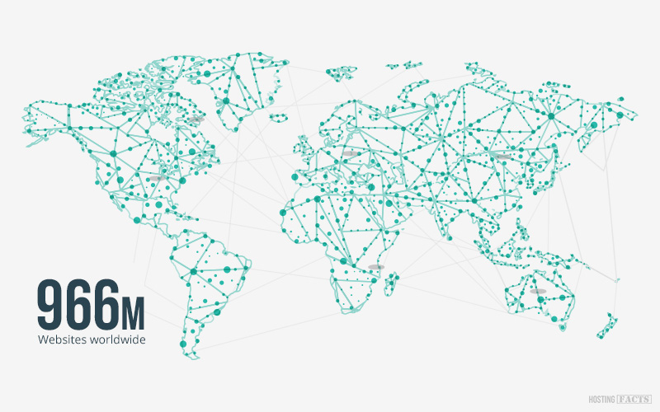
The Web – Don’t Get Lost!
Source: https://hostingfacts.com/internet-facts-stats-2016/

Slide 2
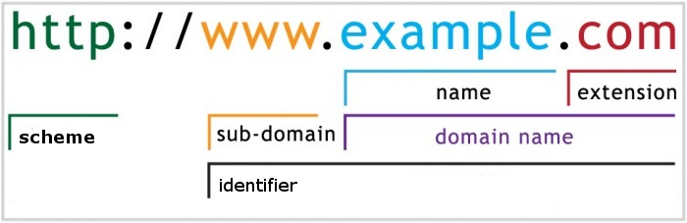
Billions of resources on the Web
How Do You Find The One You Are Looking For?
Require unique identities
Uniform Resource Locator (URL)
How you “find” a resource on the web

Slide 3
How & What
Scheme: Main identifier of “how” to access a given resource
http
https
ftp
mailto
What you are accessing
Pages
Documents
Images
Videos

Slide 4
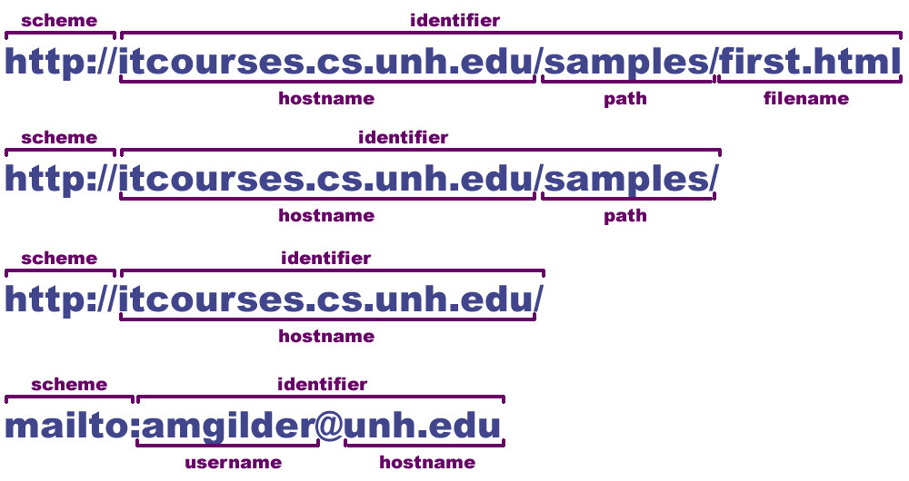
URL Component
URL Component(URL)
Scheme – tells browser how to retrieve the resource
Identifier – where to go to get it (may include a path)
Default file name
Document root folder

Slide 5
Absolute URLs
Includes hostname
Can access directly from anywhere on the web - No Matter Where You are Starting From... You will find your destination
No implied relationship
Fully Qualified Require unique identities
http://www.w3.org/
www.w3.org
http://www.amazon.com
https://www.plymouth.edu/arena/live-schedule/
http://www.hockeymonkey.com/bauer-hockey-skates-vapor-x90-jr.html

Slide 6
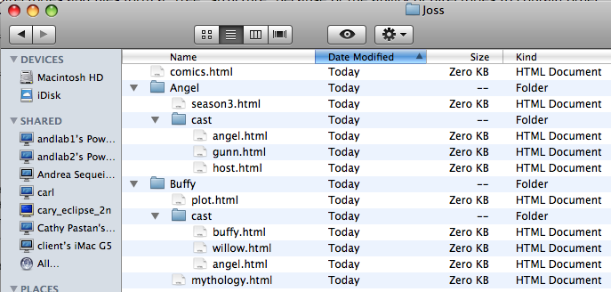
Relative URLs
Organized like your files on your personal machine

Slide 7
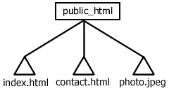
Relative URLs
Implies a Relationship
Always Based on (Relative) to Current Location
3 Possible Relationships
Parent – Always a Folder
Child – Folder
Sibling – Folder or a File
index.html
contact.html
photo.jpeg
Siblings
<a href="contact.html">Contact us</a>
<img src="photo.jpeg" alt="A photo of us" />

Slide 8
Representing Relative URLs
Siblings / “Over”
Name-of-file
Parent / “Up”
../
Children / “Down”
Name-of-folder/filename
Grandparent / “Up” “Up”
../../

Slide 9
Using URLs
Create links to navigate your site
<a href="index.html">Home page</a>
Adding Images
<img src=“photo.jpeg“ alt=“A photo of us”/ >
index.html
contact.html
photo.jpeg
<a href="index.html">Home page</a>
<img src="photo.jpeg" alt="A photo of us" />

Slide 10
Simple relative URLs
Always use relative URLs for local resources
Makes presentations easier to move and maintain
Local resources are always on the same server
So scheme and hostname are not necessary in the URL
Often, local resources are in the same folder
In this case, a path is not necessary in the URL
As such, relative URLs may be as simple as a file name
index.html
contact.html
photo.jpeg
<a href="index.html">Home page</a>
<img src="photo.jpeg" alt="A photo of us" />

Slide 11
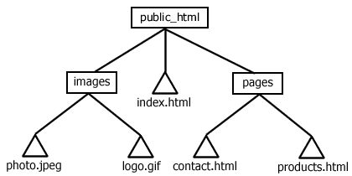
Adding subfolders
Subfolders are often used to organize files
When relative URLs consist of just a file name, the browser assumes the file is in the same subfolder as the file that contains the relative URL
When this is not the case, a path must be added to the relative URL
This path needs to specify the steps necessary to get from the folder where the file containing the URL is stored to the folder where the desired resource is stored
Relative URLs used in index.html
images/photo.jpeg
images/logo.gif
pages/contact.html
pages/products.html
<a href="pages/contact.html">Contact us</a>
<img src="images/photo.jpeg" alt="A photo of us" />

Slide 12
Parent folders
Each subfolder has one (and only one) parent folder
When we use a folder’s name in a path, the browser always looks farther down that “branch” of the directory tree
So we can’t use folder names to get back up a branch to a parent folder
Since there’s always only one parent folder, we can use the same name for all parent folders
The name we use is ..
Commonly pronounced “dot-dot”
Relative URLs used in contact.html
../index.html
../images/photo.jpeg
../images/logo.gif
products.html
<a href="../index.html">Home page</a>
<a href="products.html">Our products</a>
<img src="../images/photo.jpeg" alt="A photo of us" />

Slide 13
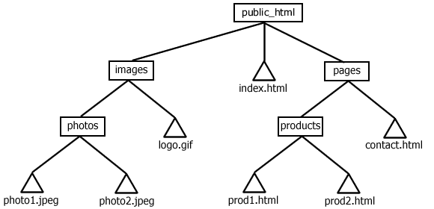
Complex hierarchies
As the number of files in a site grows, it’s common to add more subfolders to help organize them
Often these new folders are created inside other subfolders
This can result in large, complex hierarchies
In such cases, relative URLs typically contain multi-step paths
Relative URLs used in index.html
pages/contact.html
pages/products/prod1.html
images/logo.gif
images/photos/photo1.jpeg
<a href="pages/contact.html">Contact us</a>
<a href="pages/products/prod1.html">Wizbang 3000</a>
<img src="images/logo.gif" alt="Our logo" />
<img src="images/photos/photo1.jpeg" alt="Photo of Wizbang 3000" />

Slide 14
Complex hierarchies
As the number of files in a site grows, it’s common to add more subfolders to help organize them
Often these new folders are created inside other subfolders
This can result in large, complex hierarchies
In such cases, relative URLs typically contain multi-step paths
Relative URLs used in contact.html
../index.html
products/prod1.html
../images/logo.gif
../images/photos/photo1.jpeg
<a href="../index.html">Home page</a>
<a href="products/prod1.html">Wizbang 3000</a>
<img src="../images/logo.gif" alt="Our logo" />
<img src="../images/photos/photo1.jpeg" alt="Photo of Wizbang 3000" />

Slide 15
Complex hierarchies
As the number of files in a site grows, it’s common to add more subfolders to help organize them
Often these new folders are created inside other subfolders
This can result in large, complex hierarchies
In such cases, relative URLs typically contain multi-step paths
Relative URLs used in prod1.html
../contact.html
../../index.html
../../images/photos/photo1.jpeg
<a href="../contact.html">Contact us</a>
<a href="../../index.html">Home page</a>
<img src="../../images/photos/photo1.jpeg" alt="Photo of Wizbang 3000" />

Slide 16
Best practices for using links
Carefully consider both label and destination
Take user directly to intended destination
Make it clear where the link goes before it’s clicked
Use e-mail address as label of mailto: links
Carefully consider path and filenames
Human readable drives traffic
People know where they are navigating to
Carefully consider both label and destination
Make it clear where the link goes before it’s clicked
Use e-mail address as label of mailto: links
Take user directly to intended destination
Always provide a link to every local resource a user may want to reach
Don’t assume they’ll use the browser’s Back button
Keep your navigational links consistent from page to page
They should be the same links, presented in the same way, and located in the same place on every page
Unless you have a very good reason to do otherwise
Use absolute URLs for links to remote resources and relative URLs for links to local resources

Slide 17
Useful Tools/Websites
Interactive tool for html
http://www.w3schools.com/html/tryit.asp?filename=tryhtml_links
http://www.w3schools.com/tags/tryit.asp?filename=tryhtml_link_mailto
Additional Reference Material
http://www.w3schools.com/html/html_links.asp
http://www.w3schools.com/tags/tag_a.asp
https://www.w3.org/community/webed/wiki/HTML/Training/Hyperlinks
https://www.w3.org/community/webed/wiki/HTML/Training/Image

